Slide 1
Portfolio Website
Mahmudul Islam
UG02-47-18-004
Course Code – 0402
Course Name – E-commerce Lab
Department of Computer Science and Engineering
State University of Bangladesh

Slide 2
Overview
Introduction
Goals
Languages & Tools
SiteMap
Target Audience
Conclution

Slide 3
Introduction
A portfolio website is a unique way to showcase your work and let others know about yourself

Slide 4
Why do I need a portfolio?
A portfolio can set you apart from other applicants, whether in a professional or academic setting.

Slide 5
Goals
To Communicate
To Show Off
To Build Trust
Highlight Technicalities
Showcase Best of the Best Work

Slide 6
Languages & Tools
Language
HTML, CSS and JavaScript
Tools
Visual Studio Code
MySQL Server
XAMPP

Slide 7
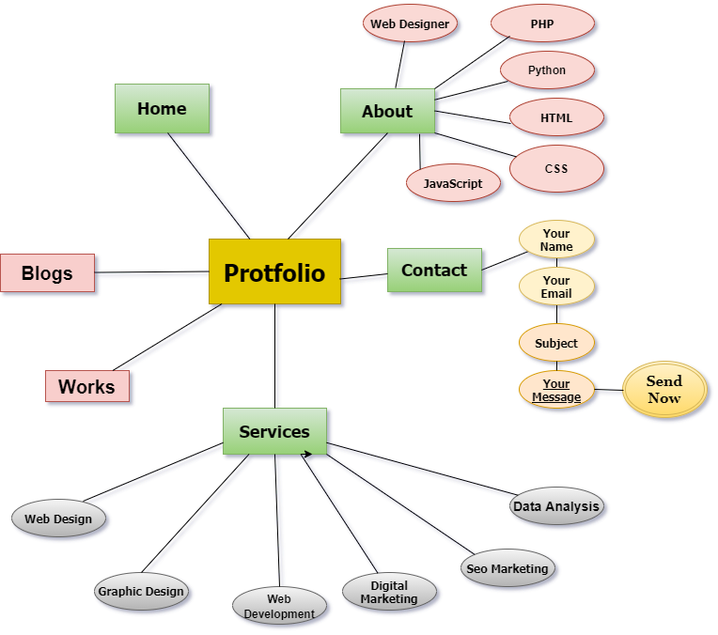
Er diagram

Slide 8
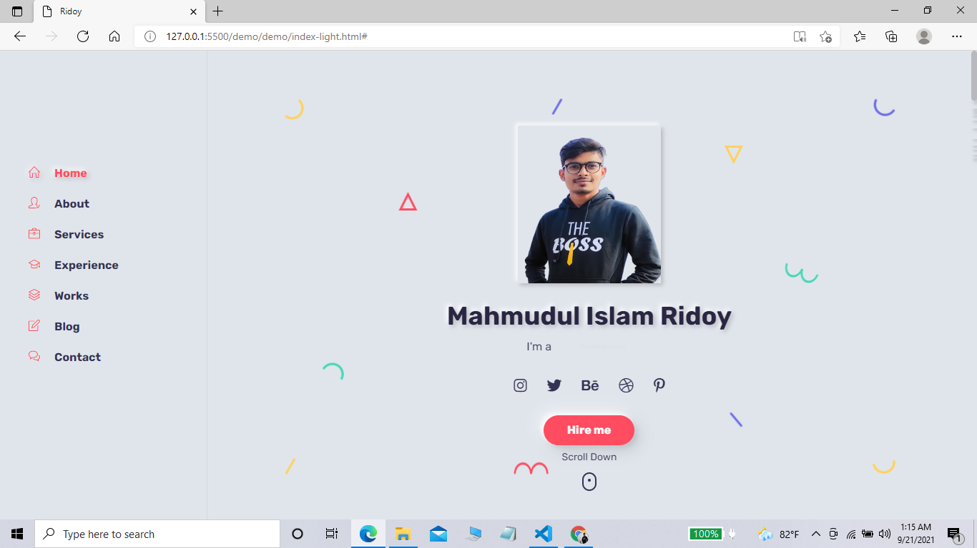
Home Page

Slide 9
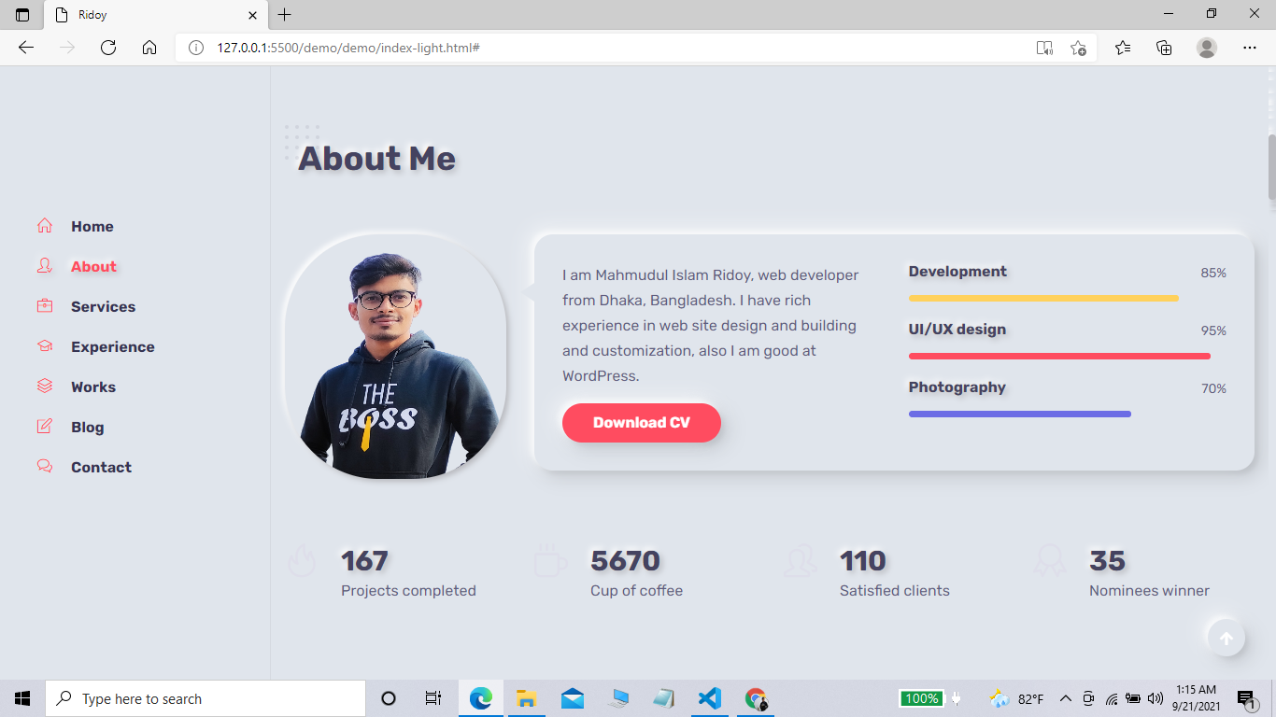

Slide 10
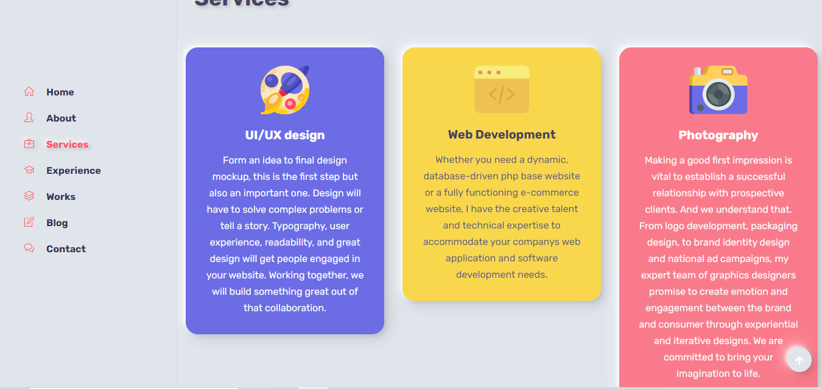
My Service Page

Slide 11
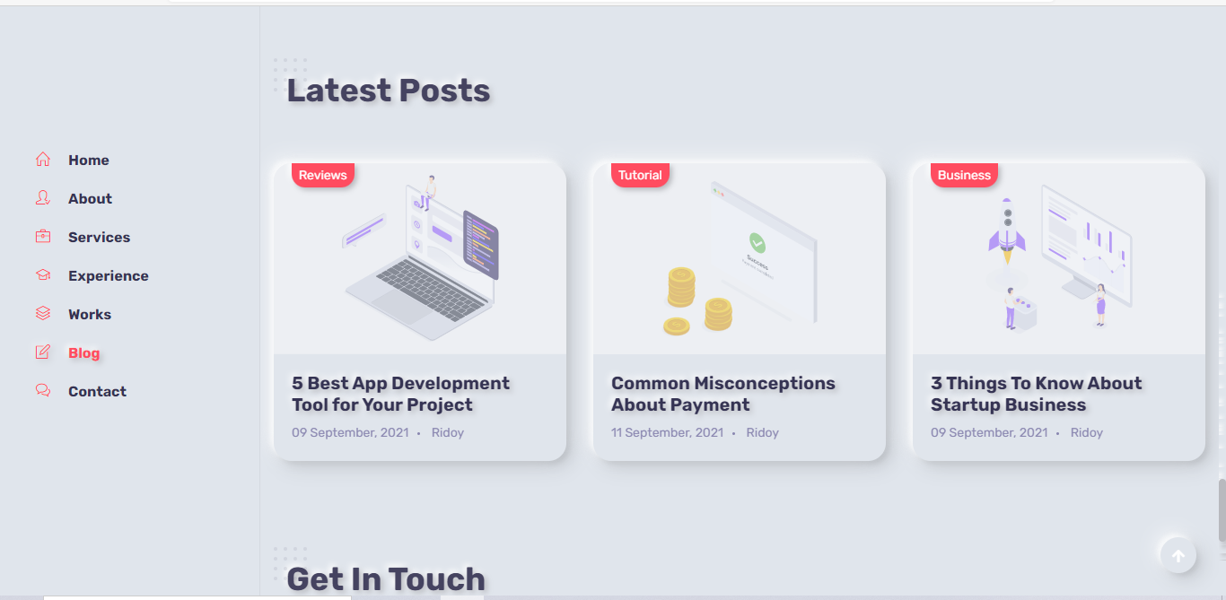

Slide 12
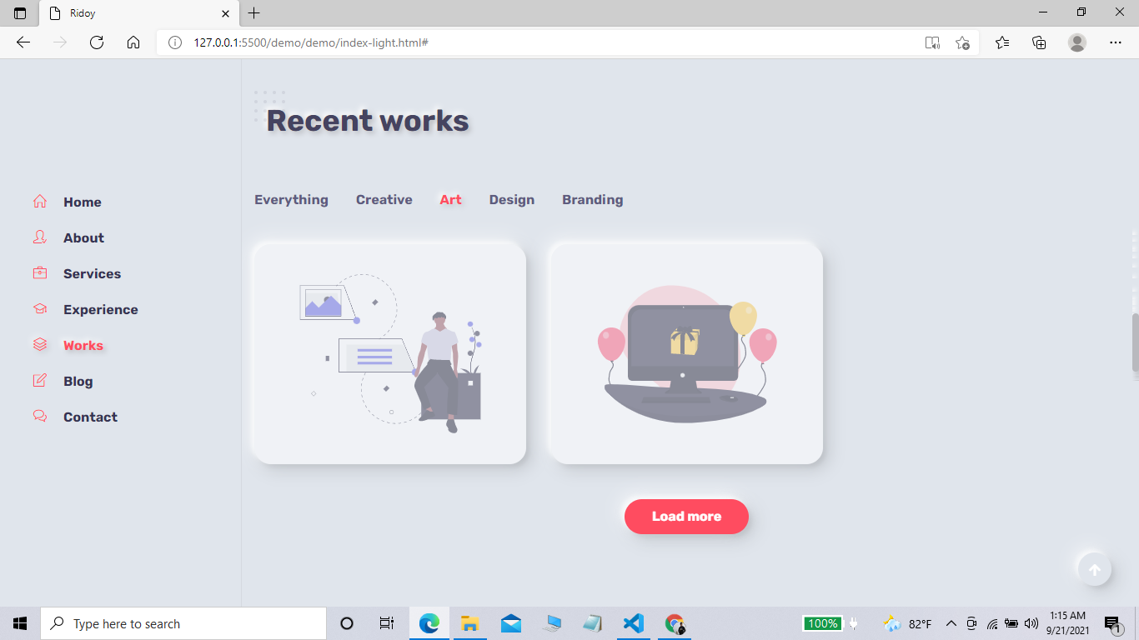

Slide 13
Advantages Of Portfolio
Provides a platform to showcase your work. .
Amplifies your online presence
Establishes your personal brand.

Slide 14
Target audience
Defining the target market or target audience is one of the most important tasks which will affect on how successful your portfolio will be in the future and who will be interested in checking it out.

Slide 15
Conclution
A portfolio website lets you show off all of your work in one place. This not only looks good to a client, but it can also help inspire you on your next projects.
Tell others about your skills and personality. Express your uniqueness through case studies. Be searchable and keep the pace with your competitors. There are no rules and everything goes as long as you are able to make the visitor smile and remember you.

Slide 16


